Slide 1
Implementing Windows Virtual Desktop in the enterprise
Presenter Name
Notes:
Information in this document, including URL and other Internet Web site references, is subject to change without notice. Unless otherwise noted, the example companies, organizations, products, domain names, e-mail addresses, logos, people, places, and events depicted herein are fictitious, and no association with any real company, organization, product, domain name, e-mail address, logo, person, place or event is intended or should be inferred. Complying with all applicable copyright laws is the responsibility of the user. Without limiting the rights under copyright, no part of this document may be reproduced, stored in or introduced into a retrieval system, or transmitted in any form or by any means (electronic, mechanical, photocopying, recording, or otherwise), or for any purpose, without the express written permission of Microsoft Corporation.
Microsoft may have patents, patent applications, trademarks, copyrights, or other intellectual property rights covering subject matter in this document. Except as expressly provided in any written license agreement from Microsoft, the furnishing of this document does not give you any license to these patents, trademarks, copyrights, or other intellectual property.
The names of manufacturers, products, or URLs are provided for informational purposes only and Microsoft makes no representations and warranties, either expressed, implied, or statutory, regarding these manufacturers or the use of the products with any Microsoft technologies. The inclusion of a manufacturer or product does not imply endorsement of Microsoft of the manufacturer or product. Links may be provided to third party sites. Such sites are not under the control of Microsoft and Microsoft is not responsible for the contents of any linked site or any link contained in a linked site, or any changes or updates to such sites. Microsoft is not responsible for webcasting or any other form of transmission received from any linked site. Microsoft is providing these links to you only as a convenience, and the inclusion of any link does not imply endorsement of Microsoft of the site or the products contained therein.
© 2017 Microsoft Corporation. All rights reserved.
Microsoft and the trademarks listed at https://www.microsoft.com/en-us/legal/intellectualproperty/Trademarks/Usage/General.aspx are trademarks of the Microsoft group of companies. All other trademarks are property of their respective owners.
August 2020

Slide 2
Abstract and learning objectives
In the whiteboard design session you will work in groups to design a Windows Virtual Desktop solution using Microsoft 365 and Azure technologies. Your solution will consider the necessary Microsoft 365 subscription required for Windows 10 Enterprise multi-user licensing, as well as the Azure Active Directory and security needs for a healthcare provider. You will need to determine how to connect Azure to the current VMware and Citrix on-premises infrastructure and the connections needed to connect this infrastructure to Azure for application access. Finally, you will need to design the Windows Virtual Desktop solution utilizing Azure virtual machines with availability and scalability to handle 24x7 operations without performance degradation.
At the end of the whiteboard design session, you will be better able to design a solution that leverages Microsoft 365 and Azure technologies together to build a secure and robust Windows Virtual Desktop infrastructure.
Notes:
In the Whiteboard Design Session (WDS), you will work in groups to design a Windows Virtual Desktop solution using Microsoft 365 and Azure technologies.
Your solution will consider the necessary Microsoft 365 subscription required for Windows 10 multi-user licensing, as well as the Azure Active Directory and security needs for a healthcare provider. You will need to determine how to connect Azure to the current VMware and Citrix on-premises infrastructure and the connections needed to connect this infrastructure to Azure for application access. Finally, you will need to design the Windows Virtual Desktop solution utilizing Azure virtual machines with availability and scalability to handle 24x7 operations without performance degradation.
At the end of the whiteboard design session, you will be better able to design a solution that leverages Microsoft 365 and Azure technologies together to build a secure and robust Windows Virtual Desktop infrastructure.

Slide 3
Step 1: Review the customer case study
Outcome
Analyze your customer needs.
Timeframe
15 minutes

Slide 4
Customer situation
Contoso Healthcare
Healthcare provider
Annual revenues of USD $200 million
National company
Headquarters in Los Angeles, CA
Network of affiliate hospitals and doctor’s offices throughout North America. Growth through acquisition
250 workstations for non-clinical users are currently supported
Data centers located in California and Northern Virginia
Current virtual desktop infrastructure investment in VMware and Citrix
Notes:
Contoso Healthcare, headquartered in Los Angeles, California, is a national healthcare provider with a network of affiliate hospitals and doctor’s offices located throughout North America. These locations continue to grow through acquisition. The nature of their business requires a high level of security of Personal Identifiable Information (PII) for their employees.
Contoso currently has approximately 250 workstations within their environment with business applications for non-clinical users from developer, finance, and knowledge departments. Contoso is currently supporting existing data centers in California and Northern Virginia with VMware for the server control plane and a partial deployment of Citrix virtual desktop infrastructure. These locations are connected with a private WAN connection and a backup VPN over broadband.

Slide 5
Customer situation
Ken Greenwald, Contoso Healthcare CTO
Understands the value of the cloud for availability and scalability
Focus on standardization of desktop images and manage published applications
Wants to avoid the need to manage desktops at individual locations
Interested in minimizing additional capital investments and maximizing current VMware and Citrix virtual desktop infrastructure in Azure
Laura Knight, Contoso Healthcare CISO
Wants to avoid data exposure of PHI and PII
Compliance to California Personal Protection Act
Focus on securing data and resources
Concerned with potential data loss due to device theft

Slide 6
Customer Needs—Security #1
Increased need for mobile devices for non-clinical users
Device theft could cause data exposure
Management of authorized applications and block unauthorized cloud applications
Manage and monitor application use and vulnerabilities within a single platform
Ability to log and audit activity to identify potential threats

Slide 7
Customer Needs—Security #2
Minimize data stored on local devices to mitigate PII exposure
Maintain compliance to California Personal Protection Act
Notes:
The business of healthcare has become more reliant on mobile devices to access patient health records, which has created a concern over theft and data exposure. Contoso would like to eliminate the possibility of any PII being located on a local device through use of a virtual desktop infrastructure.
Since Contoso Healthcare is headquartered in California, they are required to comply to the California Personal Protection Act, which is very similar to GDPR requirements.

Slide 8
Customer Needs—Availability and Scalability
24x7 access to applications
High availability with limited capital investment
Ability to scale resources as demand increases
Network connections should be resilient with low latency to applications
Notes:
Being a healthcare provider, Contoso has a requirement for applications to be accessible 24x7, so any infrastructure should be designed with high availability and scalability in mind.

Slide 9
Customer Needs—Deployment Acceleration
Eliminate the need to update and manage local devices
Utilize the current VMware and Citrix virtual desktop infrastructure for the control plane for application access and delivery
Create a standardized desktop image for users to access Microsoft 365 and legacy on-premises applications

Slide 10
Customer objections #1
The CTO at Contoso does not want to invest in new workstations and mobile devices to support the standardized desktop image. This includes non-OS, Macs, Android, and thin clients. Can these devices support the new image?
The CISO at Contoso needs to be convinced that data will not be exposed. How would Microsoft support the data protection needs?

Slide 11
Customer objections #2
Contoso must be able to log and audit all activity on the desktop image. How will this be handled within the cloud and on-premises environments?
Connections between the cloud and existing data centers must be secure and reliable to support their requirements. How will this be addressed and monitored?
Contoso has made a substantial capital investment in their current data centers that they do not want to decommission. So would like to leverage existing infrastructure where possible.

Slide 12
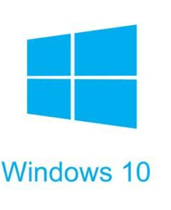
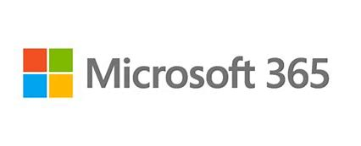
Common scenarios #1
Microsoft 365 subscription
Windows 10 multi-user license
Device management
Multi-factor authentication
Data protection
Identity protection
Conditional access

Slide 13
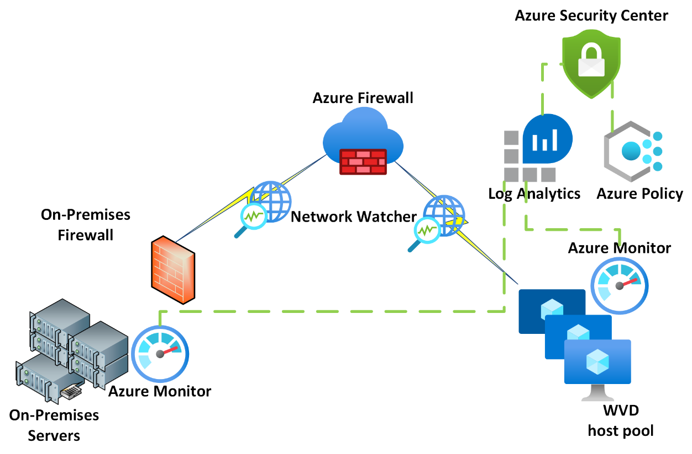
Common scenarios #2
Security
ISO 27001 and HIPAA controls
Monitoring and alerting
Data encryption
Identity and access management
Secure and Centralize file storage
Notes:
Common scenario of how Azure Monitor and Network Watcher can be used for both Azure and non-Azure VMs and network connections. On the right, the on-premises servers are connected to Azure Monitor with an agent and Network Watcher is monitoring the connection between the on-premises datacenter and Azure. In Azure, Azure Monitor is connected to the Windows Virtual Desktop host pool instances, and network watcher is monitoring the connect to these hosts and the VNET. The metric and activity log information is then fed into Azure Monitor, Log Analytics, Azure Policy, and Azure Security Center for managing these resources for performance, activity, and compliance.

Slide 14
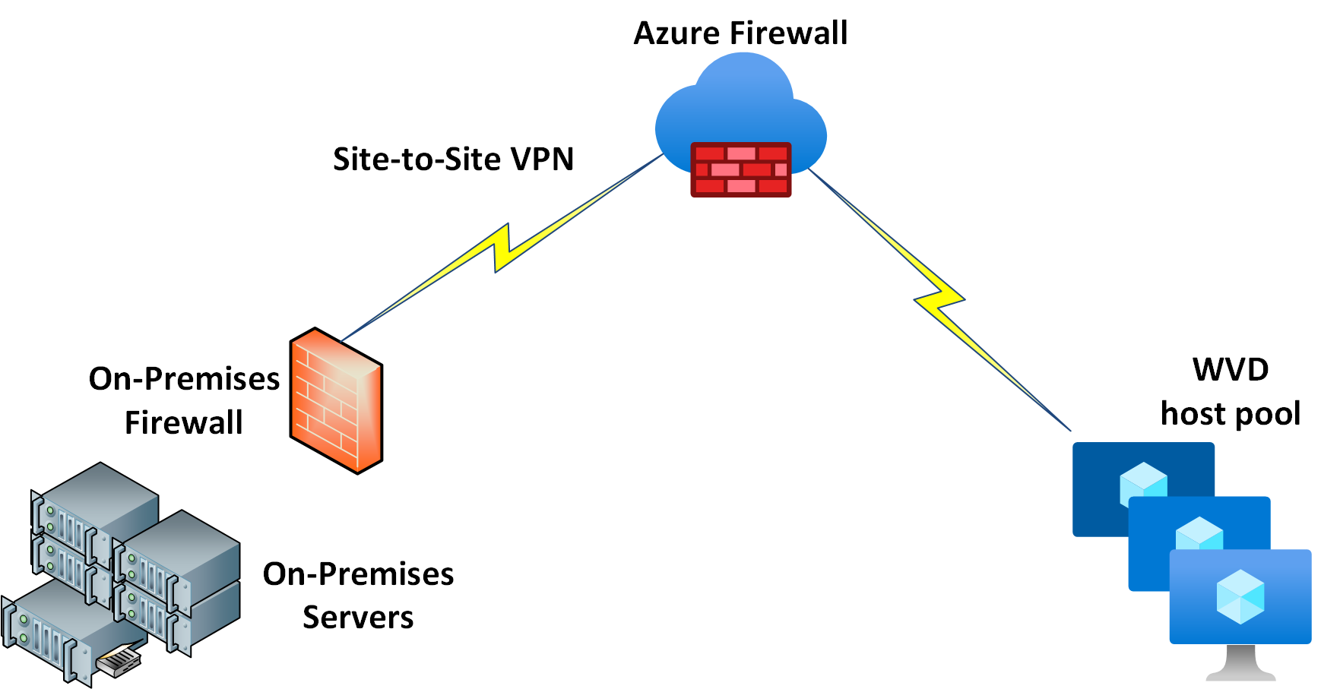
Common scenarios #3
Network connectivity
Create a virtual network for virtual machine pool
Connection to on-premises data center
Determine the User connection to desktop image
Remote Desktop Client
Web Client
Apple iOS or Android Remote Desktop app
Notes:
Diagram presenting the site-to-site connection configuration for the on-premises datacenter to connect to Azure through a VPN connection between the on-premises firewall and the Azure firewall.

Slide 15
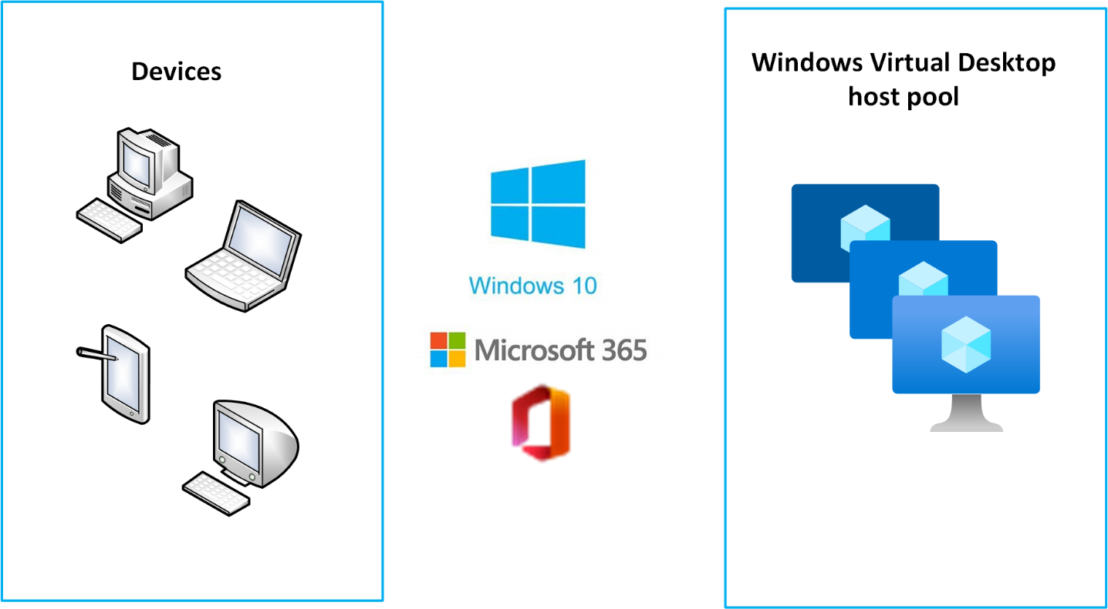
Common scenarios #4
Windows Desktop image
New Windows 10 Enterprise multi-user workspace
VHD image of existing workspace
Application delivery through the current VMware and Citrix environment
Notes:
Diagram referencing that there are multiple devices that will need to connect to the Windows desktop virtual image for Windows 10 and Microsoft 365 applications via the WVD hostpool.

Slide 16
Common scenarios #5
Windows Virtual Desktop host pool
Define the number of concurrent sessions
Create virtual machine availability set
Define desktop image

Slide 17
Step 2: Design the solution
Outcome
Design a solution and prepare to present the solution to the target customer audience in a 15-minute chalk-talk format.
Timeframe
60 minutes
Business needs (10 minutes) | Respond to questions outlined in your guide and list the answers on a digital Whiteboard.
Design (35 minutes) | Design a solution for as many of the stated requirements as time allows. Show the solution on a Whiteboard.
Prepare (15 minutes) | Identify any customer needs that are not addressed with the proposed solution. Identify the benefits of your solution. Determine how you will respond to the customer’s objections. Prepare for a 15-minute presentation to the customer.

Slide 18
Step 3: Present the solution
Outcome
Present a solution to the target customer in a 15-minute chalk-talk format.
Timeframe
30 minutes (15 minutes for each team to present and receive feedback)
Directions
Pair with another table.
One table is the Microsoft team and the other table is the customer.
The Microsoft team presents their proposed solution to the customer.
The customer asks one of the objections from the list of objections in the case study.
The Microsoft team responds to the objection.
The customer team gives feedback to the Microsoft team.

Slide 19
Wrap-up
Outcome
Identify the preferred solution for the case study.
Identify solutions designed by other teams.
Timeframe
15 minutes

Slide 20
Implementing Windows Virtual Desktop in the enterprise
Whiteboard Design Session – Preferred Solution

Slide 21
Preferred target audience
Ken Greenwald, CTO
Laura Knight, CISO
Desktop Administrators
Service Delivery Managers
Infrastructure, Virtualization, Storage, and Networking Teams

Slide 22
Microsoft 365 Subscription requirements
Microsoft 365 E3/E5
Microsoft 365 A3/A5/Student Use Benefits
Microsoft 365 F3
Microsoft 365 Business Premium
Windows 10 Enterprise E3/E5
Windows 10 Education A3/A5
Windows 10 VDA per user
Ideal subscription for Contoso’s needs would be:
Microsoft 365 E5 with EMS E5
These subscriptions address the requirements for mobile device management, data classification and information protection, and conditional access policies.
Notes:
Microsoft 365
1. What Microsoft 365 subscription is required for Windows 10 multi-user licensing?
Microsoft 365 licenses that support Windows Virtual Desktop include M365 E3, E5, A3, A5, F3, and Business Premium.
2. What subscription is required for Contoso's mobile device requirements?
Microsoft Enterprise Mobility + Security E3 or E5 are required for Intune MDM.
3. What subscription is needed to classify and protect PHI and PII access?
A Microsoft 365 E5 license is required for the full suite of data protection, information protection and classification, and advanced threat protection capabilities.
4. What subscription is necessary to enforce device access on the local network only?
Conditional access policies are available on EMS E3 and E5. However, risk-based conditional access policies are only available on EMS E5, which would be best suited for this organization.
5. Why did you select the Microsoft 365 subscription(s)?
A Microsoft 365 Enterprise E5 will be required with Enterprise Mobility + Security E5 to support the full list of requirements outlined by the customer. Microsoft 365 licenses that support Windows Virtual Desktop include M365 E3, E5, A3, A5, F3, and Business Premium. However, the additional requirements for mobile device management, data classification and information protection, and conditional access policies require the E5 and EMS E5 licenses. Business Premium licensing is also only supported to up to 300 users.

Slide 23
Security requirements
ISO 27001 and HIPAA requirements
Azure Security Center Standard Tier and Azure Policy initiatives for HIPAA and ISO 27001 controls
California Personal Protection Act (similar to GDPR)
Monitoring and alerting
Azure Monitor agents installed on all Azure and on-premises virtual machines.
ATP should be used to monitor threats.
Azure Sentinel should be used for incident response and investigation
Data security and encryption
Cloud App Security for managing authorized applications.
All data in-transit will be sent across an encrypted SSL connection. Data at-rest will be encrypted in Azure file storage
Identity and access management
Azure Active Directory service with Azure AD Connect hash synchronization to on-premises Active Directory domain
Secure and Centralize file storage
Azure files will be used as the centralized file storage and share. File access will be controlled through Azure Active Directory roles
Notes:
Security
1. What is required to audit, log, and monitor controls for ISO 27001 and HIPAA?
Azure Policy initiatives for ISO 27001 and HIPAA should be enabled for the resource groups that are created to govern the Windows Virtual Desktop infrastructure. In addition, Azure Security Center should be upgraded to the Standard tier subscription to properly monitor and alert on control compliance to ISO 27001 and HIPAA standards.
To address compliance with the California Personal Protection Act, the Azure Policy initiative for GDPR will be assigned and custom policies will be added as needed to comply with the CPPA.
2. How will you address monitoring these controls in Azure and the on-premises data centers?
Azure Monitor agents should be installed on all Azure and on-premises virtual machines in order to govern the Azure Policy initiatives. These agents will provide activity logs that can be monitored within Azure Security Center.
ATP should be used to monitor threats.
Azure Sentinel should be used for incident response and investigation.
3. How will you avoid data exposure for data in transit and data at rest?
All connections for data in-transit will be transmitted through an encrypted SSL connection. Data at-rest will be encrypted at-rest.
Cloud App Security for managing authorized applications. This will be used to block unauthorized cloud storage services to protect data from being copied.
4. How will you maintain identity access management for the cloud and current Active Directory infrastructure, and how will they synchronize?
The cloud identity will be created within Azure Active Directory. This will be the primary identity source for Microsoft 365, Windows Virtual Desktop, and Azure services. User identities from Active Directory Domain Services will be imported into Azure Active Directory to maintain user login credentials. Azure AD Connect will be installed at Contoso Healthcare's data center in order to synchronize user credentials for single sign-on. Password Hash Synchronization will be used so that users have the ability to authenticate through the data center Active Directory services or the cloud Azure Active Directory services.
5. How will you address the secure and centralized file storage needs of the organization?
Azure Files is the preferred method for storage use with Windows Virtual Desktop. In addition, FSLogix can be used in conjunction with Azure Files to manage user virtual desktop profiles. Azure Files must be deployed in the same region as the Virtual Machine pools.
6. Describe the reasons for the specific security services selected.
Azure Monitor, Log Analytics, ATP, Cloud App Security, Azure Security Center, and Azure Sentinel will provide services to monitor, manage and investigate any potential vulnerabilities, threats, or anomalies within the environment to protect users and data across Azure, Microsoft 365, and on-premises resources.

Slide 24
Network Connectivity
Regions and Resource Groups
West US and East US regions should be peered in Azure to decrease latency to California and Northern Virginia
Single resource group for the Window Virtual Desktop infrastructure
Virtual Network
Three peered VNETs: Virtual desktop host pool network, VPN to on-premises network, and Bastion host network
Load balancer will be used in front of the host pool virtual machines to decrease the public IP attack surface
Azure to on-premises network
Minimum requirement is Azure Firewall with Site-to-Site VPN
Ideal solution would be ExpressRoute to headquarters in CA and Northern VA.
Monitoring and alerting
Azure Monitor
Azure Log Analytics
Advance Threat Protection (ATP)
Network Watcher
Service Map
Azure Security Center
Azure Sentinel
Notes:
Networking
1. In what region or regions will you deploy resources and why?
In order to decrease latency West US and East US regions should be peered in Azure to decrease latency to California and Northern Virginia.
A single resource group will be deployed for the Window Virtual Desktop infrastructure resources.
2. How will you design the resource groups to support your design?
The entire Windows Virtual Desktop infrastructure should be created within a single resource group. This will allow for ease of management of the resources and the ability to analyze and review the consumption easily within the Azure subscription.
3. How will your virtual networks (VNETs) be configured for IP addresses and subnets?
The resource group should be configured with at least three separate VNETs with subnets. The first would be the VNET for the Virtual Desktop hostpool, the second will be the VNET used to connect to the on-premises network, and the third would be a VNET for a Bastion host to be used for secure virtual machine access for support. The VNETs will be peered with only the Virtual Desktop hostpool VNET having gateway access for security. This configuration of VNETs provides a level of isolation to the networks for security and control.
4. How will you connect to Contoso Healthcare's data centers to minimize latency and maximize security?
The VNET identified above will connect the on-premises network utilizing an Azure Firewall that creates a site-to-site VPN connection to the primary datacenter in Los Angeles. The recommendation would be to also utilize an Azure ExpressRoute connection directly from the Los Angeles datacenter to Azure West US, if available, and the VPN be used for backup connectivity to maximize connection speed and security, and East US to the Northern Virginia datacenter.
5. What inbound ports, if any, need to be open to the session hosts for users to connect securely?
The answer is none. Because of reverse-connect, no inbound ports are required to the session hosts, thus reducing the attack surface (https://docs.microsoft.com/en-us/azure/virtual-desktop/security-guide#session-host-security-best-practices).
6. What will you use to identify and monitor threats on the network?
Azure Monitor, Azure Log Analytics, and Advanced Threat Protection should all be turned on with actions and alerts to the security group.
The Azure Security Center standard subscription will provide a central dashboard for monitoring, locating, and alerting on common threats found in the Microsoft Threat database.
Network Watcher will be utilized to monitor network connection speeds and health.
Service Map will be utilized for additional monitoring of virtual machines.
Azure Sentinel will be the central source for incident response and investigation of threats, vulnerabilities, and anomalies.
7. How would you monitor network throughput and latency over the network?
Turning on Network Watcher within the VNETs will provide logs and analysis of the network speeds across VNETs and to the on-premises network.

Slide 25
Windows Desktop image
New Windows 10 multi-user workspace with Office 365 ProPlus
Application delivery through current Citrix app marketplace
Authorized applications managed through Cloud App Security
Managed image through WVD with creating a VHD image as an alternative option
User connection
Any of these are viable options
Remote Desktop Client
Web Client
Apple iOS or Android Remote Desktop app
Notes:
Windows Virtual Desktop image
1. How will the standardized desktop image be created?
The recommendation would be to create the managed WVD image that Contoso Healthcare is wanting to deliver to their users. Optionally, they could also create a VHD for the standard image. Details on this process are in the links provided in the student guide. Another option is to have an image created with Windows 10 multi-user licensing and Office365 ProPlus at the time of creating the Windows Virtual Desktop host pool, then making adjustments to that image based on custom requirements. You could use the following automated image building solutions to create and manage this image, such as Azure Image Builder (https://docs.microsoft.com/en-us/azure/virtual-machines/windows/image-builder-overview) or Build image with Packer (https://docs.microsoft.com/en-us/azure/virtual-machines/windows/build-image-with-packer) to manage images in Azure.
2. How will applications be delivered to the desktop image?
To simplify the application delivery and licensing, Contoso Healthcare would like to leverage the current Citrix infrastructure that they have in place. To accomplish this, a shortcut can be provided on the standard desktop image for the Citrix app marketplace that provides users with the applications they are authorized to access.
3. What are the connection options for users to access the Windows Virtual Desktop image?
There are multiple connection options for users to access their Windows Virtual Desktop. The Remote Desktop client application can be used with Windows 10, Windows 7, Android, macOS, or iOS. Users can also connect through an HTML5-capable web browser. Since we are unsure of the full scope of operating systems on the 500 existing workstations within Contoso Healthcare, we recommend connection through the web browser on desktop devices and using the Remote Desktop app on mobile devices.
4. What are the minimum system requirements for users to access the Windows Virtual Desktop image?
Officially supported browsers are Microsoft Edge, Internet Explorer, Apple Safari, Google Chrome, and Mozilla Firefox (v55 or higher). Windows 10, Windows 10 IoT Enterprise, Windows 7, and macOS operating systems are supported. Microsoft Remote Desktop app is available for Android and iOS mobile devices.

Slide 26
Windows Virtual Desktop host pool
Define the number of con-current sessions –
250 users
Single host pool for Knowledge, Developer, and Finance users
Create virtual machine availability set –
25 DS4s v3 virtual machines
10 users per virtual machine
Notes:
Windows Virtual Desktop host pool
1. How many concurrent sessions will be required to access the virtual desktop image?
We will design the capacity to support the full 250 sessions that were identified in our initial discussions with the customer.
2. How many virtual machines are required to support the number of concurrent sessions?
You should have used the Azure pricing calculator to create an initial capacity estimate. This estimate calculated at most 31 DS2s v3 instances as the base availability set with 8 virtual desktop sessions per host (according to: https://docs.microsoft.com/en-us/windows-server/remote/remote-desktop-services/virtual-machine-recs).
Additional instances to scale as capacity increases. The example estimate can be accessed here: https://azure.com/e/296a636cede24f1c859b42a63687c80c.

Slide 27
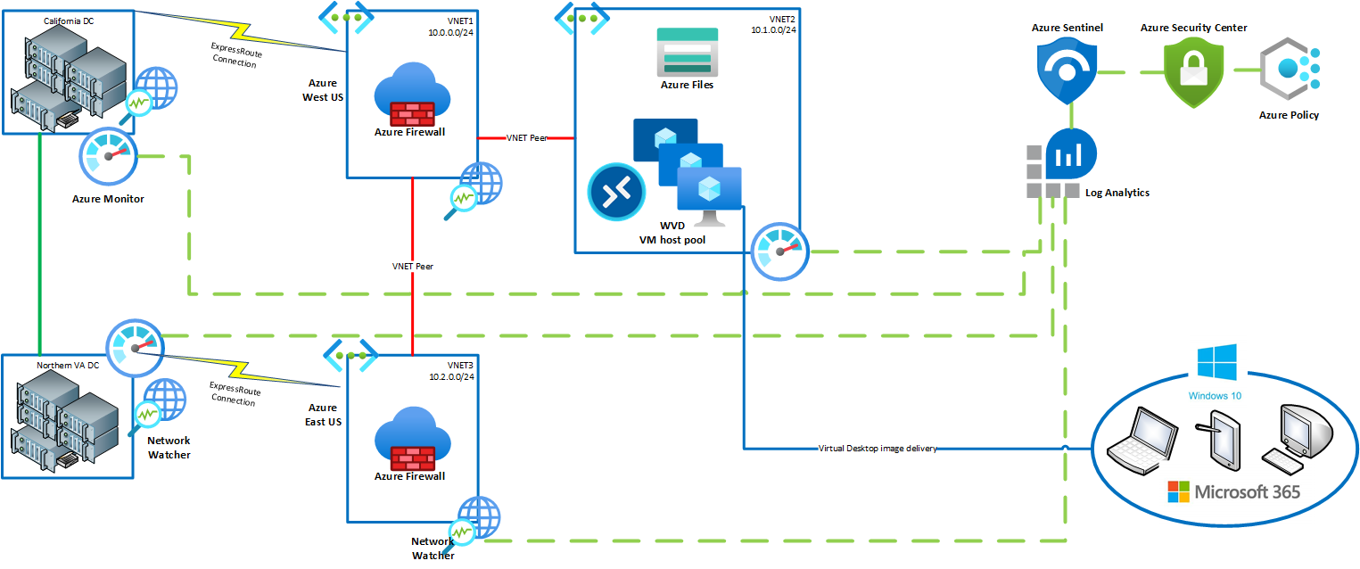
Solution Diagram
Notes:
The diagram on this slide shows a possible solution for Contoso's Windows Virtual Desktops. The California datacenter is connecting to the Azure West US region, and the Northern Virginia datacenter is connecting to the East US region utilizing ExpressRoutes to each. The West US and East US region VNETs are peered for highspeed backbone connection with a pass-through peering allowed from East US to the WVD VM host pool VNET that is peered with West US.

Slide 28
Preferred objections handling #1
Objection
The CTO at Contoso does not want to invest in new workstations and mobile devices to support the standardized desktop image. Can these devices support the new image?
Potential answer
Windows Virtual Desktop is flexible in the way that users can access their virtual desktop. The design will utilize web browser access to the virtual desktop on workstations, and the remote desktop app on mobile devices.

Slide 29
Preferred objections handling #2
Objection
The CISO at Contoso needs to be convinced that data will not be exposed. How would Microsoft handle data protection?
Potential answer
The designed solution for Contoso Healthcare includes Microsoft 365 E5 with Enterprise Mobility + Security (EMS) E5. This provides a full suite of data and information protection to classify sensitive data and audit activity. Cloud App Security can also be used to block access to unauthorized file sharing services to avoid users from copying files to unprotected locations. Data protection controls can be monitored through Microsoft 365 security adviser, and Azure Security Center.

Slide 30
Preferred objections handling #3
Objection
Contoso must be able to log and audit all activity on the desktop image. How will this be handled within the cloud and on-premises environments?
Potential answer
Azure Monitor and Azure Log Analytics will be activated within the Azure environment. Azure Monitor agents will be deployed to the on-premises virtual machines to monitor activity across the entire infrastructure.

Slide 31
Preferred objections handling #4
Objection
Connections between the cloud and existing data centers must be secure and reliable to support their requirements. How will this be addressed and monitored?
Potential answer
The initial design will utilize a secure and encrypted site-to-site VPN connection from Azure to the Detroit data center. An option has also been provided to utilize an Azure ExpressRoute connection to provide private dedicated connectivity from Azure to the Detroit data center. Network Watcher will be used to monitor network traffic and throughput over the connections. Azure Security Center and Advanced Threat Protection will be in place to monitor and alert on potential vulnerabilities and threats.

Slide 32
Preferred objections handling #5
Objection
Contoso has made a substantial capital investment in their current data centers that they do not want to decommission. How can the infrastructure be architected to support the current data centers?
Potential answer
The designed solution has been architected to integrate the current application delivery configuration through Citrix into the standardized Windows Virtual Desktop image. In addition, Azure AD Connect will be used with hash synchronization to provide a single sign-on environment between the Azure Active Directory identity management and the existing on-premises Active Directory domain. As hardware is depreciated within the current data centers, application servers can be migrated to Azure and the Windows Virtual Desktop image can be updated for the new location of these servers.

Slide 33
Customer Quote
"Azure has designed a secure and manageable infrastructure that can grow with Contoso Healthcare. This depth and breadth will allow us to meet both our business needs and regulatory requirements for our applications. Not to mention ensuring that our healthcare practitioners will have access to the patient data that they need when they need it.“
Ken Greenwald, CTO of Contoso Healthcare

